Slide 1
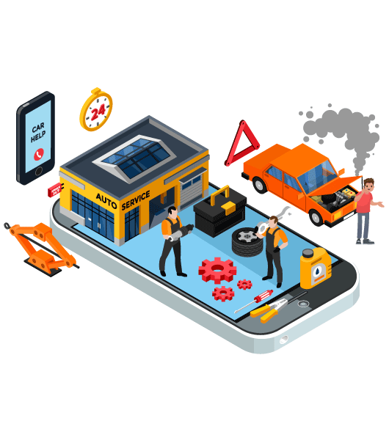

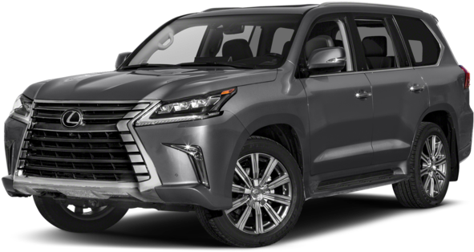
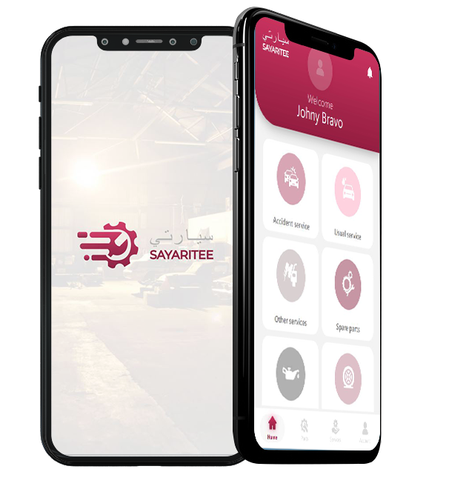
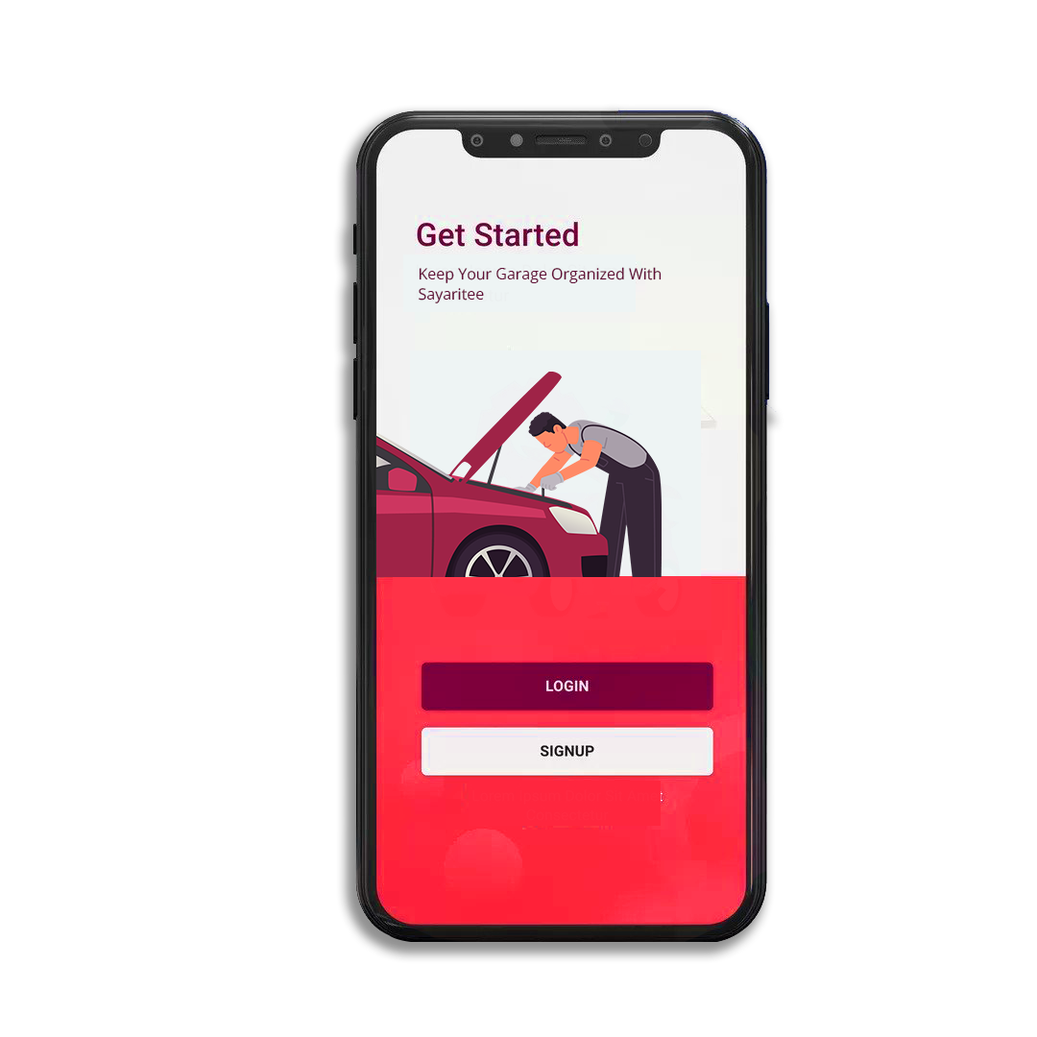
SAYARITEE / MY VEHICLE / MI VEHÍCULO
First-ever App for Motorists in Qatar

Slide 2
The story
The idea came to Sultan, Founder & CEO in 2021 when a large number of Qatari locals had complained to him: it had always been hard to find someone to help them with solutions to their chronic auto-related headaches and hassles due to the lack of an adequate mobile App.
The work started on the start-up - meetings and agreements with motorists and a wide range of services suppliers, insurance companies, throughout the country - to learn about requirements and see all technical, commercial, and marketing implications, that helped with the conceptualisation, design, development, test runs, implementation of the complete operation system, continuous upgrades of the App - through full-scale funding all by the Founder & CEO himself, up till today.

Slide 3
Traction 1
The App sayaritee.com has been successfully tested repeatedly, is ready to take off and hit the ground running as we have got all the key components in place, and it will be a huge hit when launched on the market.
▪ 1,000,000 cars and 50,000 new vehicles in addition, every year
▪ QAR 6,000 is spent on a car annually
▪ First-ever mobile App to connect motorists and automotive services providers
▪ Monthly Recurring Revenue (those seeking fund greater than $1 mn demonstrate at least $50,000 in MRR — and be on track to achieve $80,000 in MRR over the next 6 months. Those metrics should help start-ups command a $6 to $10 mn valuation)
▪ Annual Recurring Revenue
▪ Gross MRR Churn Rate (monthly recurring revenue lost in a given month/ monthly recurring revenue lost in at the beginning of the month)
▪ Paid CAC, cost per customer acquired through paid marketing channels (total sales and marketing spend in given month / total customers acquired via paid channels and sales)

Slide 4

Traction 1

Slide 5
Traction 1
Break out | jan | feb | mar | apr | may | jun | jul | aug | sept | oct | nov | dec
New | 187500 | 225000 | 194400 | 434678 | 246453 | 275170 | 276889 | 354298 | 292099 | 401845 | 340526 | 398571
Expansion | 232500 | 279000 | 233280 | 161741 | 321460 | 206377 | 192619 | 223077 | 417284 | 312546 | 356005 | 350742
Reactivation | 150000 | 180000 | 136080 | 141523 | 225022 | 298100 | 288928 | 262443 | 208642 | 267897 | 247656 | 286971
Contraction | 45000 | 54000 | 29160 | 60653 | 107153 | 103189 | 96309 | 91855 | 69547 | 89299 | 123828 | 111600
Churn | 75000 | 90000 | 48600 | 70762 | 53577 | 68792 | 60193 | 52489 | 83457 | 74416 | 108349 | 79714
Change | 60000 | 72000 | 223560 | 141523 | 117869 | 194912 | 288928 | 328054 | 319918 | 342312 | 371483 | 366685
 | 750000 | 900000 | 972000 | 1010880 | 1071533 | 1146540 | 1203867 | 1312215 | 1390948 | 1488314 | 1547847 | 1594282

Slide 6
Traction 1

Slide 7

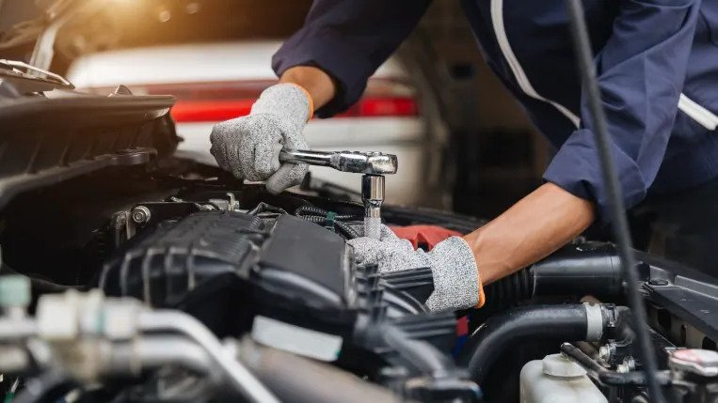

The Now
▪ Cars used day and night ▪ Breakdowns ▪ Accidents ▪ Maintenance ▪ Insurance ▪ Bureaucracy ▪ Carwash ▪ Services providers are difficult to find ▪ 4 cars in each Qatari local family, on average ▪ NO HELP
▪ NO APP to click on and arrange ALL services via mobile, at once

Slide 8


Problem
There’s NO single-window mobile App for motorists that helps them arrange all their automotive requirements.
Simultaneously, auto industry services providers’ capability to create value for their market is inhibited by their absence from the digital space.

Slide 9
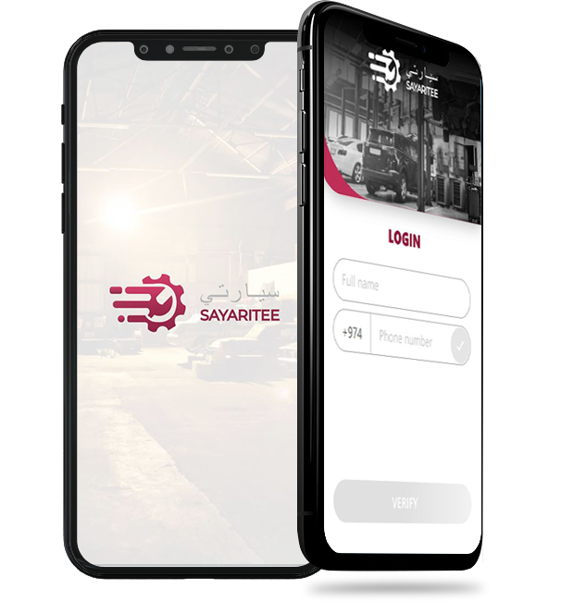
Solution
sayaritee.com is the first-ever App that connects motorists and leading auto-industry services providers for real-time user connections – supported by 24/7 LIVE customer service.
For motorists - free membership and access. It removes the chronic hassles and headaches associated with mobility, leaving motorists free to enjoy careless driving only.
Subscription- and commission-based membership for services providers - garages, spare parts, insurance companies, roadside recovery, car wash - that offers them a complete new ecosystem and connection into one unified network that covers the entire country.

Slide 10

Market Size
INITIAL SERVICE AREA
In terms of coverage of the App, Qatar currently leads as the market with tremendous demands.
It will be followed by Middle East, Central America (SICA), US, Europe in the next 18-24 months.
Qatari local motorists own 1,000,000 cars, and buy 50,000 new cars every year.
The Expansion Plan is to include 800,000 expat motorists in Qatar by 2023, TFS will market the products on a massive scale.

Slide 11
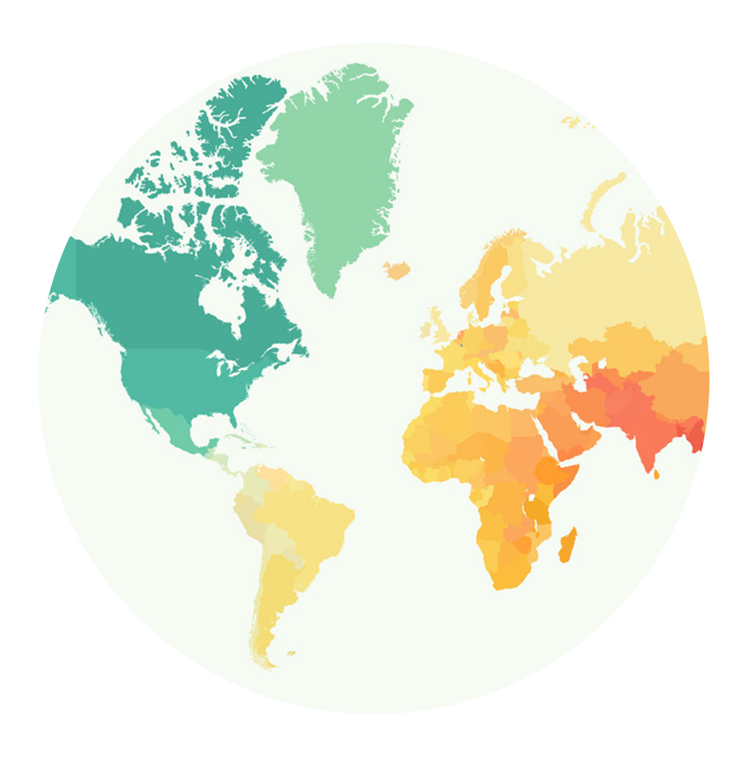
Market Size
EXPANSION PLAN - TARGET AREAS
The App will go on fast scaling in:
▪ Middle East – Dubai: 1.6 million cars
▪ Central America - El Salvador: 654,000 cars
▪ Central America - SICA economic zone: 6 million cars
▪ US - American Automobile Ass’n: 57 million members
▪ Europe – France: 32 million cars;
Italy: 40 million cars;
Germany: 42 million cars.
Regional HQs in Iraq and El Salvador this year to prep for multiregional growth push.
The Expansion Plan is for the next 18-24 months, TFS will market the products on a massive scale.

Slide 12

Competition
None.

Slide 13

Why Now?
Having spent the past 2 years talking to the market and building up our platform that layers for Qatari local motorists a convenience-focused package atop a network of independent services provider the country, the App is ready for launch.
Motorists’ pain, overwhelming univocal complaints over the lack of help and outcry for a much-needed solution have been detected / documented.
Agreements with a wide range of leading services suppliers have been reached.
sayaritee.com is a most useful and welcome asset, there is a particular urgency for it to go ON-LINE in a BIG WAY and there is need for investment in its solution.

Slide 14
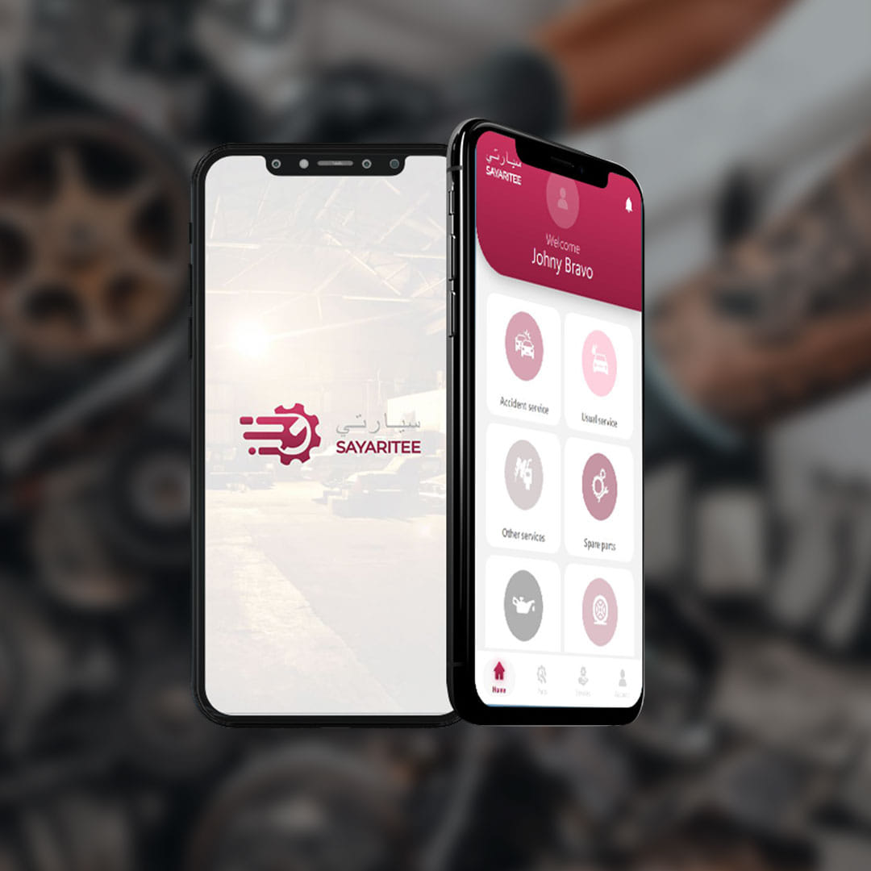
Product 1
This App integrates leading individual services providers of the field selected and qualified by TFS based on their grades and expertise to ensure the highest Customer satisfaction.
It helps motorists to effortlessly arrange all services requirements, and provides Best Practice solutions not limited to, but including:
• Garages,
• Insurance companies,
• Spare parts,
• Roadside assistance,
• Car wash,
• Car rental services.
Your lg

Slide 15
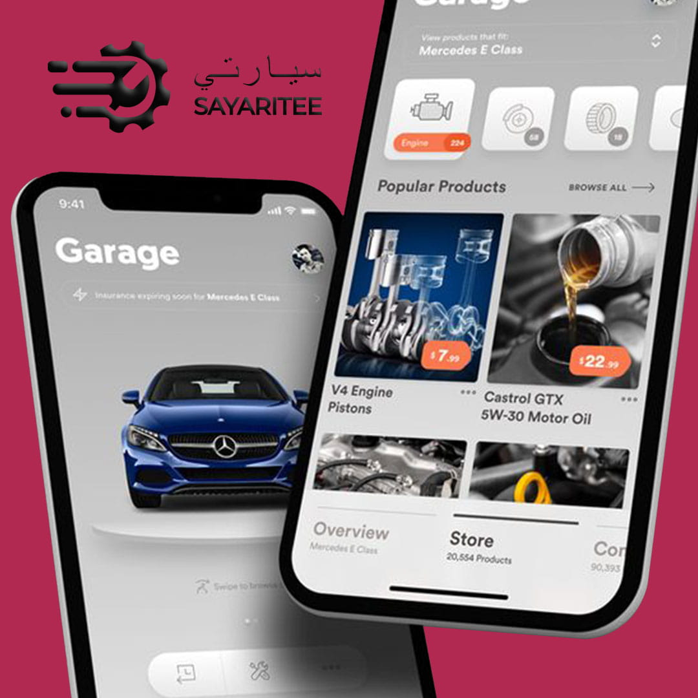
Product 2
Key features, services offered, including but not limited to:
• Periodical Servicing
• Car Warranty - Extended and Exceptional Warranty
• Insurance Claims and Dealings
• Vehicle Registration
• Vehicle Inspection (ISTIMARA)
• Garage Services
• 24/7/365 Road Side Assistance
• Collision Assistance
• Auto Theft or Auto Fire Assistance
• Other Services:
• Electronic Vehicle Maintenance
• Electronic Vehicle Charging
• Car washing facilities
• Total Auto Protection Plans for Fleets
Your lg

Slide 16
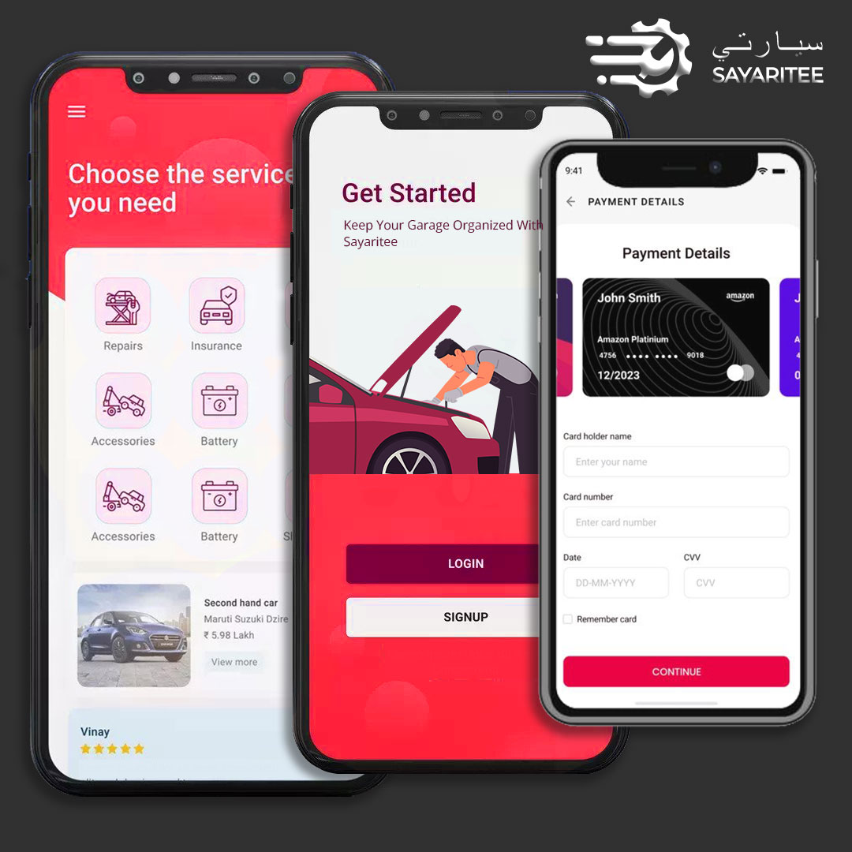
Product 3
Accessible through the DASHBOARD on the motorists’ mobile phones, the management of the App provides REAL-TIME overall picture of the auto industry services related to the individual vehicles, through:
• Information sharing immediate & evident as all data stored in the same database, • Automatic integration with other related services providers, • Accurate and optimal resource management thanks to the digital platform, • Co-operation with qualified and certified services providers and vendors, • Exceptional Customer satisfaction, enabling & delivering never-before-seen top-level services, • Digital Services/Maintenance Record System where all historic data from all sources can be retrieved any time of the day from a single location, the management and services providers have instant access to the relevant data, • Rate your experience • Nationwide data warehouse for Big Data analysis.

Slide 17
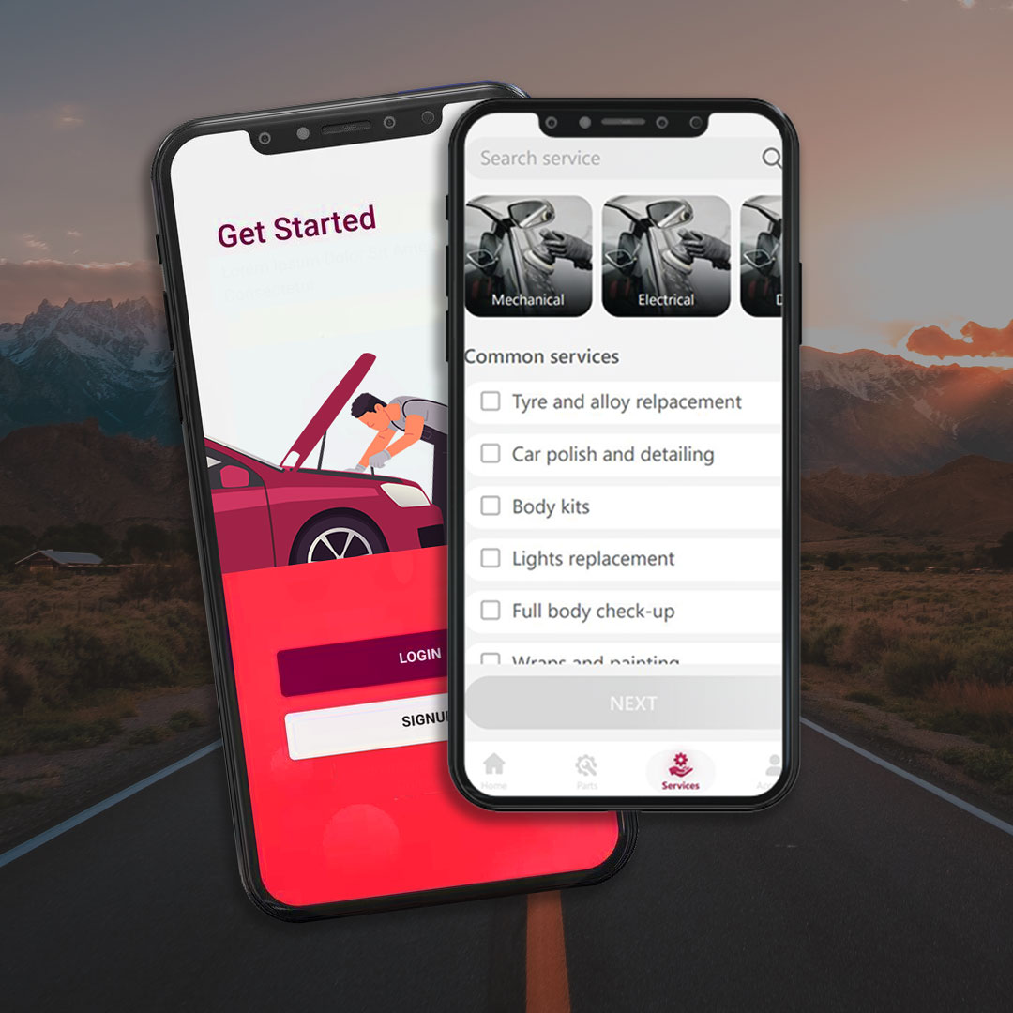
Product 4
A request for quotation is sent by the motorists via the App to all the registered service providers within a particular category.
Once quotes received and reviewed, an appointment is booked with the preferred service centre recommended in the App.
Also, it keeps detailed logs on work completed earlier, and reminds you of routine maintenance requirements.
Motorists have the facility to select one of the garages to repair their car at their doorstep, thus saving hassles, time and cost by using our App.
End-to-end visibility is ensured from Purchase Order through to the completion and financial reports.
The App offers intellectual capital with IT systems and solutions – continuously upgraded – to ensure ultimate Best Practice services both for motorists and auto industry services providers in Qatar.

Slide 18
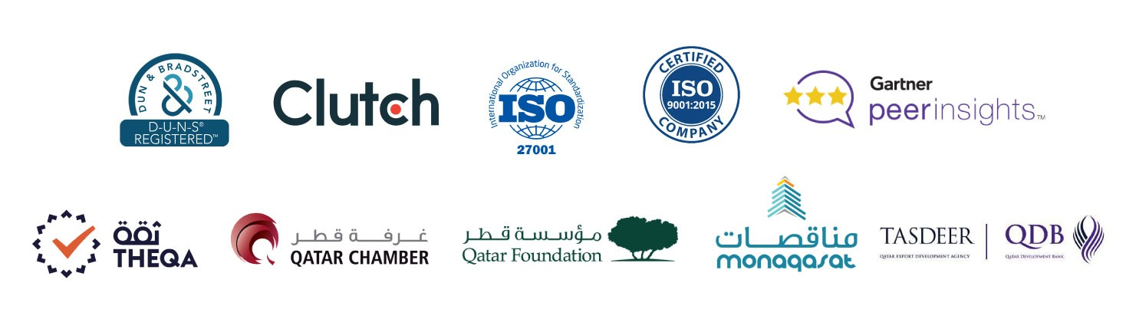
Traction 2 – Awards, Cetifications
▪ THEQA Award was issued to Lumenpath by Qatar Chamber of Commerce & Industry in recognition of the company’s pioneering efforts by the creation of a Digital Marketplace as well as the high-quality engagement in building and improving e-Commerce in Qatar.

Slide 19
Traction 3 – Customer Testimonials

Slide 20
Traction 4 – Financial Position
We have calculated the potential sales revenue for SAYARATEE in 2022-23 as initial discussions have already been held, and agreements reached with a wide range of various services suppliers.
Therefore, we have decided to first concentrate on generating proven revenues of QAR 23.904 million in the 1st year. In the 2nd year, it will be QAR 50.646 million, and QAR 70 million in the 3rd year.

Slide 21
Traction 5 – Comprehensive Income
We have calculated the potential sales revenue for SAYARATEE in 2022-23 as initial discussions have already been held, and agreements reached with a wide range of various services suppliers.
Therefore, we have decided to first concentrate on generating proven revenues of QAR 23.940 million in the 1st year. In the 2nd year, it will be QAR 50.646 million, and QAR 70 million in the 3rd year.

Slide 22
Traction 6 – Cash Flows
We have calculated the potential sales revenue for SAYARATEE in 2022-23 as initial discussions have already been held, and agreements reached with a wide range of various services suppliers.
Therefore, we have decided to first concentrate on generating proven revenues of QAR 23.904 million in the 1st year. In the 2nd year, it will be QAR 50.646 million, and QAR 70 million in the 3rd year.

Slide 23
Traction 7 – Changes in Equity
We have calculated the potential sales revenue for SAYARATEE in 2022-23 as initial discussions have already been held, and agreements reached with a wide range of various services suppliers.
Therefore, we have decided to first concentrate on generating proven revenues of QAR 23.904 million in the 1st year. In the 2nd year, it will be QAR 50.646 million, and QAR 70 million in the 3rd year.

Slide 24
Traction 8 – User Increase
▪ 1,000,000 cars, and 50,000 new vehicles in addition every year
▪ QAR 6,000 is spent on a car annually
▪ First-ever mobile App to connect motorists and automotive services providers
▪ Weekly Revenue Growth rate of 5% translating to 12.6% in a year,
▪ No need for a massive sales and marketing, customer acquisition budget,
▪ Strong customer lifetime value,
▪ Remarkable average customer’s annual profit contribution,

Slide 25
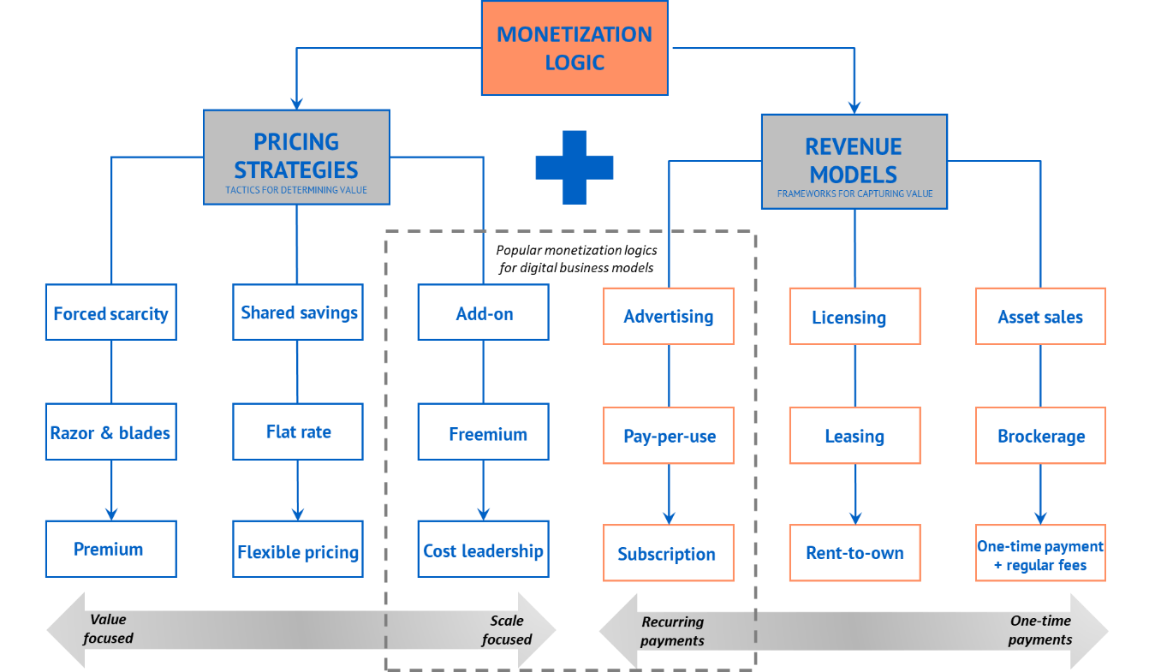

Business Model 1
• revenue model: change how revenue is generated through new value propositions and new pricing models (to take advantage of economies of scale)
Rene Bohnsack’s smart business model

Slide 26
Business Model 1
• pricing model: change how revenue is generated through new value propositions and new pricing models (to take advantage of economies of scale)
Rene Bohnsack’s smart business model

Slide 27
Business Model 1
• enterprise model: specialize and configure the business to deliver greater value by rethinking what is done in-house and through collaboration
Rene Bohnsack’s smart business model

Slide 28
Business Model 1
• industry model: redefine an existing industry, move into a new industry or create a new industry
Rene Bohnsack’s smart business model

Slide 29

Business Model 7
• Revenue streams: The way a company makes income from each customer segment. Several ways to generate a revenue stream:
○ Asset sale – Selling ownership rights to physical goods: e.g., retail corporations.
○ Usage fee – Money generated from the use of a particular service: UPS.
○ Subscription fees – Revenue generated by selling access to a continuous service: e.g., Netflix.
○ Lending/leasing/renting – Rights to an asset for a period: car leasing
○ Licensing – Revenue generated from charging for the use of a protected intellectual property.
○ Brokerage fees – Revenue generated from an intermediate service between 2 parties: e.g., broker selling a house for commission.
○ Advertising – Generated from charging fees for product advertising.

Slide 30
Business Model 1
it is important to start with the end in mind. This means thinking about the direction in which you want your business to grow and how to put all the right pieces in place to make this possible
Infrastructure
• Key activities: creating a highly efficient value chain via operating the single-window mobile App both for motorists and services providers to drive costs down, improve efficiency, boost revenue.
• Key resources: human, financial, physical, and intellectual/software.
• Key Partners/Partner Network: automotive services suppliers, related financial organisations, manufacturers, logistics, government entities.

Slide 31

Business Model 2
Offering
• Value propositions: The value proposition provides value through various elements such as:
• newness / innovativeness,
• performance,
• customization,
• "getting the job done",
• design,
• brand/status,
• price,
• cost reduction,
• risk reduction,
• accessibility, and
• convenience/usability.
○ Qualitative – overall customer experience and outcome

Slide 32


Business Model 3
Customers
• Customer Segments:
○ Niche market :
- Premium customers
• Customer Channels:
○ Own channel
• Customer Relationships:
○ Personal assistance
○ Dedicated personal assistance
○ Self-service
○ Automated services

Slide 33

Business Model 6
Finances
• Cost structure: The most important monetary consequences while operating under different business models.
○ Classes of business structures:
▪ Value-driven – Less concerned with cost, it focuses on creating value for products and services: e.g., Louis Vuitton, Rolex.
○ Characteristics of cost structures:
▪ Fixed costs – web and App expenses, Cloud, Customer service, Rental.
▪ Variable costs – Marketing, App R&D, innovation.
▪ Economies of scale – go down as the number of services and products ordered goes up.
▪ Economies of scope – Costs go down due to incorporating other businesses like Customer Support which have a direct relation to the original product.

Slide 34

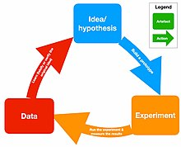
Business Model 8
Continuous deployment (only for software development)
Continuous deployment & continuous delivery whereby all code that is written for an application is immediately deployed into production, which results in a reduction of cycle times. TFS works to deploy new code into production as often as 50 times a day.
Innovation accounting
It focuses on maintain accountability and maximize outcomes by measuring progress, planning milestones, and prioritising. The topic was later expanded upon to include three levels of innovation accounting related to the types of assumptions being validated.
Build – Measure – Learn
The Develop–Measure–Learn loop emphasizes speed as a critical ingredient to customer development. Effectiveness is determined by our ability to ideate, quickly develop a minimum viable product of that idea, measure its effectiveness in the market, customers' reactions and behaviours against developed Apps, and learn from that experiment. It is a learning cycle of turning ideas into Apps, measuring, and then deciding whether to persevere or pivot the idea; this process repeats as many times as necessary. The process can also be viewed as a test of hypotheses. The phases of the loop are: Ideas → Develop → Measure → Data → Learn.

Slide 35

Fundraising Ask
The expected funding requirement is QAR 12 million (USD 3.2 million). It will be used to cover progress and the company’s operations that will become more complex, related human resources and office space.
The money will also be put towards R&D and innovation to continuously develop sayaritee.com, as well as fast scaling of the operations and adjustment of App to the Middle East, Central America (SICA), US, Europe in 18-24 months.
The original plan / track may change / modify / evolve in unforeseeable ways post-investment engagement with real world consequences. It is absolutely mission-critical for possible changing / modification that will reward an early investor who is with us as a partner for alignment on this change / modification / evolution and agree on the way forward together. Given this crucial agreement on the App’s evolution, investor engagement is in fact key to the mission for the growth of App and company.

